Slide 1
WEEK 5
Omnichannel Optimization, Next Best Action,
and Patient Predictive Modeling
One decision per prescriber per week: call, email, digital, or nothing.
How an NBA engine makes it — and how you know it worked.
Andi Cupallari · Applied Data Science and AI in Pharma Commercial · Fall 2026 · Monday, October 12
Week 5 — Omnichannel, NBA and Patient Predictive Modeling · Pharma DS&AI · Fall 2026
1 / 48
Notes:
Fourth coding night. One notebook in two halves around the break. Homework 1 is due tonight 11:59 PM; nothing released tonight.

Slide 2
AGENDA
Tonight
2.5 hours · one notebook in two halves · one exercise · Homework 1 due tonight
0
The question, and the trap
Response vs. uplift — 15 min
1
How an NBA engine works
Three components, one loop, one design choice — 15 min
2
Live 1 — the data, the trap, affinity prediction
Notebook §1–4 — 35 min
3
Live 2 — causal inference and uplift modeling
Potential outcomes · confounding · S/T/X-learners · notebook §5 — 35 min
4
Saturation, rules, scoring
Notebook §6–7 — 15 min
5
Evaluating a policy: OPE and bandits
Notebook §8–9 — 15 min
6
Patients, orchestration, exercise
Notebook §10–11 — 20 min
Week 5 — Omnichannel, NBA and Patient Predictive Modeling · Pharma DS&AI · Fall 2026
2 / 48

Slide 3
00
The question, and the trap
Week 4 said who the prescribers are. Tonight: what to do with each one, this week.
Week 5 — Omnichannel, NBA and Patient Predictive Modeling · Pharma DS&AI · Fall 2026
3 / 48

Slide 4
0 · FROM WEEKS 3–4
What tonight inherits
Week 4 segments
Core · Movers · Access-constrained
Entrenched · Long tail
$ per script
1 incremental NBRx ≈ $1,200
Call $180 · email $2 · digital $6
Hold-out discipline
Measure on data the model never saw
Tonight: randomize 25% of decisions
The NBA engine
context · value · measurement
Break-even for a $180 call: 0.15 incremental NBRx in two weeks. Most calls don't clear it.
Week 5 — Omnichannel, NBA and Patient Predictive Modeling · Pharma DS&AI · Fall 2026
4 / 48
Notes:
Collect nothing — HW1 is online. Ask who brought one HCP per segment from Week 4; keep them for the exercise.

Slide 5
0 · THE QUESTION
The Omnichannel Lead, every Monday
GLUCOREN · 6,000 targeted HCPs · four possible actions
“For each prescriber, this week: a rep call, an approved email, a digital placement, or nothing — and how will we know it worked?”
Rep call
$180 per touch
Approved email
$2 per touch
Digital placement
$6 per touch
Nothing
$0 per touch
6,000 HCPs × 26 weeks = 156,000 of these decisions in H1 2026
We owe back
We will not pretend
▸ One action per HCP per week, with the expected incremental value behind it — and 'nothing' as a real answer
▸ That 'who prescribes after a call' tells us whom to call — it tells us who prescribes
Week 5 — Omnichannel, NBA and Patient Predictive Modeling · Pharma DS&AI · Fall 2026
5 / 48

Slide 6
0 · THE TRAP
Response vs. uplift
Response = what happens after the action. Uplift = that, minus what would have happened anyway.
Dr. Hale — Core
Dr. Bakshi — Movers
if called
6.3 NBRx
if called
2.9
if not called
6.2
if not called
2.0
uplift +0.1 → −$60 net. A sure thing.
uplift +0.9 → +$900 net. A persuadable.
prescribes anyway
wouldn't anyway
Why a response model fails
prescribes
if touched
Sure things
Core · uplift ≈ 0
Persuadables
Movers · worth the touch
▸ It ranks Dr. Hale first — he prescribes most.
▸ Only persuadables return the $180.
▸ Finding them needs the difference, and the difference needs randomization.
doesn't
if touched
Sleeping dogs
over-touched Entrenched · uplift < 0
Lost causes
Long tail · nothing moves them
Model the difference, not the level. The four types: Radcliffe & Surry (2011).
Week 5 — Omnichannel, NBA and Patient Predictive Modeling · Pharma DS&AI · Fall 2026
6 / 48
Notes:
The slide to come back to all night. Hale and Bakshi are exercise Part A HCPs.

Slide 7
01
How an NBA engine works
Three components — segmentation, affinity, NBA — one weekly loop, one design choice that makes it learnable.
Week 5 — Omnichannel, NBA and Patient Predictive Modeling · Pharma DS&AI · Fall 2026
7 / 48

Slide 8
1 · THE ENGINE
An NBA engine in one picture
Three components: segmentation → affinity → NBA. Terms: suggestions (Veeva), orchestration (IQVIA), business rules (Axtria), single customer view (McKinsey)
Rx panel (Week 2)
1 · Segmentation
micro-segments
Week 4
3 · NBA layer
Suggestion → rep
CRM activity
Eligibility
business rules · affinity floor
Single customer view
CDP · identity · consent
Approved email
Email / web
Outcome
NBRx · engaged · complaint
Scoring
uplift × $ − cost
Consent
2 · Affinity prediction
observed for a subset →
collaborative filtering
Digital
Access (rejects)
Selection
argmax + explore
Nothing
Preference survey
the log: context · action · probability · outcome → next week's segments, affinities and uplift model
Segmentation says who. Affinity says how to reach them. The NBA layer says whether it pays, under the rules. The log feeds all three.
Week 5 — Omnichannel, NBA and Patient Predictive Modeling · Pharma DS&AI · Fall 2026
8 / 48
Notes:
Walk left to right: data → one customer view → segmentation and affinity → the NBA layer → an action → an outcome → the red loop. Say now: the log must record the probability with which the action was chosen — §8 runs on that column.

Slide 9
1 · THREE COMPONENTS
Segmentation → affinity → NBA
What each answers, what it needs, where tonight builds it
 | 1 · Segmentation / micro-segmentation | 2 · Affinity prediction | 3 · NBA layer
Question | Who is this HCP? | Which channels reach them? | Which action pays this week?
Input | Rx, patient mix, switching, channel response (Week 4) | Observed engagement on a subset of HCP × channel cells; a preference survey | Randomized touch log; rules; affinities; value per script
Method | k-means, two-stage; supervised growth score | Collaborative filtering (matrix factorization) + segment prior for cold start | Uplift model (X-learner); business rules; argmax with exploration
Output | Segment and growth group per HCP | Affinity per HCP per channel (full matrix) | One action per HCP per week, with its probability
Fails when | Unstable across refreshes | Cold start with no prior; stated ≠ revealed | No randomization; engagement used as the outcome
Tonight | Inherited from Week 4 | Notebook §4 | Notebook §5–8
IQVIA's NBA engine: 'dynamic micro-segmentation and AI/ML-based scoring' on a '360-degree view of HCP preferences' — the same three parts.
Week 5 — Omnichannel, NBA and Patient Predictive Modeling · Pharma DS&AI · Fall 2026
9 / 48

Slide 10
1 · THE LOOP
One HCP, one week
The same cycle, 6,000 times every Monday
Monday: state
segment · baseline · touches in last 4 wks · last action · consent
Eligible actions
rules remove call / email / digital
Score each
τ̂ₐ(x) × $1,200 − cost(a)
Pick
argmax — or random in 25% of weeks
Act + log
action, probability, context
2 weeks later
NBRx, engagement, complaints → the log
Example — Dr. Bakshi (Movers), week of Mar 2
Movers · 2.0 NBRx/2w · 1 touch · last: none · consent ✓
call ✓ email ✓ digital ✓ none ✓
call +0.90 → +$900 · email +0.30 → +$358 · digital +0.45 → +$534
call
logged: call, p = 0.62
2.9 NBRx · call completed
Next week the state has changed (2 touches, last action = call) — and so does the decision.
Week 5 — Omnichannel, NBA and Patient Predictive Modeling · Pharma DS&AI · Fall 2026
10 / 48
Notes:
Numbers from the exercise Part A. The point: the decision depends on the state, and the state depends on last week's decision. That is why fatigue (§6) is a feature in the model and a rule in front of it.

Slide 11
1 · THE DESIGN CHOICE
Randomize a share of the decisions
Industry: a test-and-control design (ZS); McKinsey: 'A/B testing in the field'. Bandit language: the exploration arm.
156,000 HCP-weeks
75% — legacy rules engine
Call frequency by decile · fortnightly email to consented HCPs · digital on rotation
Who gets called depends on decile — the same thing that drives prescribing
25% — randomized
none · call · email · digital, each with probability 0.25
regardless of who the HCP is
Learns the targeting rule
Learns the effect
▸ Any model fit here learns 'high decile → call → high NBRx'. Useful for affinity (§4); useless for uplift.
▸ Uplift (§5), the fatigue curve (§6), OPE (§8) all come from here.
Week 5 — Omnichannel, NBA and Patient Predictive Modeling · Pharma DS&AI · Fall 2026
11 / 48
Notes:
Everything causal tonight comes from the 25%. The most common way NBA programs die is switching this off after the first good quarter.

Slide 12
1 · VOCABULARY
The vocabulary, and where it comes from
Definitions in the Field Guide (Part 11); sources in the Reading Pack (Part F)
Term | Who uses it this way
Next Best Action (NBA) | IQVIA 2025; Veeva Systems 2015; EY 2023; McKinsey 2022
Suggestions / triggers / signals | Veeva Systems 2015; Axtria 2020; ZS 2024; IQVIA 2026
Next Best Experience (NBX) | ZS 2026; Axtria 2025
Omnichannel orchestration | IQVIA 2026; IQVIA 2024; Axtria 2025; McKinsey 2022
Micro-segmentation | IQVIA 2025; McKinsey 2022
Channel preference / affinity; affinity prediction (collaborative filtering) | IQVIA 2024; IQVIA 2018; IQVIA 2023; IQVIA 2025; Koren, Bell & Volinsky, IEEE Computer 2009
Saturation / fatigue; frequency cap | IQVIA 2018; IQVIA 2023; Axtria 2025
Business rules / suppression rules | Axtria 2025; IQVIA 2026
Promotion response | Axtria 2021; ZS 2024
Uplift / incremental lift; persuadables, sure things, lost causes, sleeping dogs | Stochastic Solutions (N. Radcliffe & P. Surry) 2011; Athey & Imbens, PNAS 2016
Test and control; holdout; randomized test cell (the 'exploration arm') | ZS 2026; McKinsey 2022; IQVIA 2026
Engagement vs. impact | ZS 2026; IQVIA 2025
Single customer view / customer 360 / common data spine / CDP | IQVIA 2026; IQVIA 2024; McKinsey 2022; EY 2023
Closed-loop learning; suggestion acceptance | ZS 2026; IQVIA 2025; Axtria 2025
Human in the loop; guardrails | McKinsey 2025; ZS 2026; IQVIA 2025
Patient journey; closed patients; provider behavior | Komodo Health 2023; IQVIA 2025
Contextual bandit; offline policy evaluation (IPS, SNIPS, doubly robust) | Li, Chu, Langford & Schapire (WWW); Dudík, Langford & Li (ICML) 2010
Week 5 — Omnichannel, NBA and Patient Predictive Modeling · Pharma DS&AI · Fall 2026
12 / 48
Notes:
One minute. Two terms are not pharma vocabulary — contextual bandit and offline policy evaluation come from online advertising. Say which, and students can read a vendor deck.

Slide 13
02
Live, part 1 — the data, the trap, affinity prediction
Notebook §1–4
Week 5 — Omnichannel, NBA and Patient Predictive Modeling · Pharma DS&AI · Fall 2026
13 / 48

Slide 14
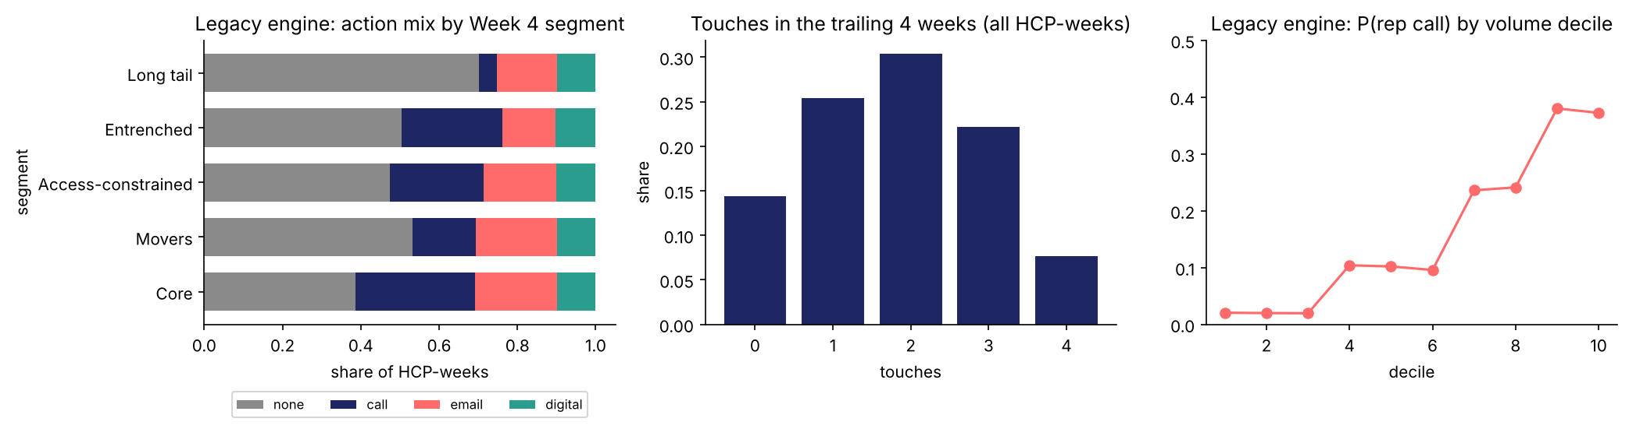
2 · THE DATA
One row = one HCP, one week, one decision
glucoren_touch_log.csv · 156,000 rows · plus the Week 4 segments file
Context
segment · decile
trailing NBRx
calls / emails / digital in 4 wks
weeks since call · last action
consent · reject rate
Action
none · call
email · digital
Probability
p(action | context)
0.25 if randomized
the rules' prob. otherwise
Outcome
NBRx next 2 weeks
engaged (open / click / completed)
complaint
1.83
touches per HCP per 4 weeks (legacy)
2,450 → 135
emails without consent → complaints
Week 5 — Omnichannel, NBA and Patient Predictive Modeling · Pharma DS&AI · Fall 2026
14 / 48
Notes:
§1–2. Right panel: P(call) rises with decile — the targeting rule a model would learn.

Slide 15
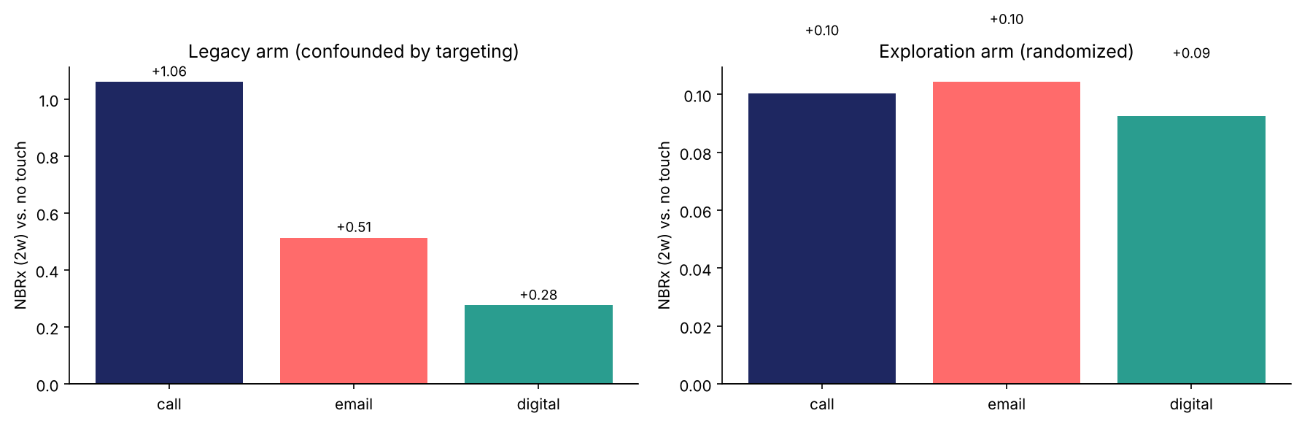
2 · THE TRAP, MEASURED
Called vs. not called: +1.06 NBRx on the legacy arm, +0.10 randomized
Response model, top decile
▸ 62% Core · 30% Movers · 0% Entrenched
▸ It learned the call plan and called it response.
Honest average effect of a call
▸ +0.10 NBRx = $120 for $180. On average, a call loses money.
Not 'does a call work' but 'for whom does a call pay' — a heterogeneous-effect question.
Week 5 — Omnichannel, NBA and Patient Predictive Modeling · Pharma DS&AI · Fall 2026
15 / 48
Notes:
§3. The 10× gap is the targeting rule, not the rep. Industry name for the model family: promotion response modeling (Axtria).

Slide 16
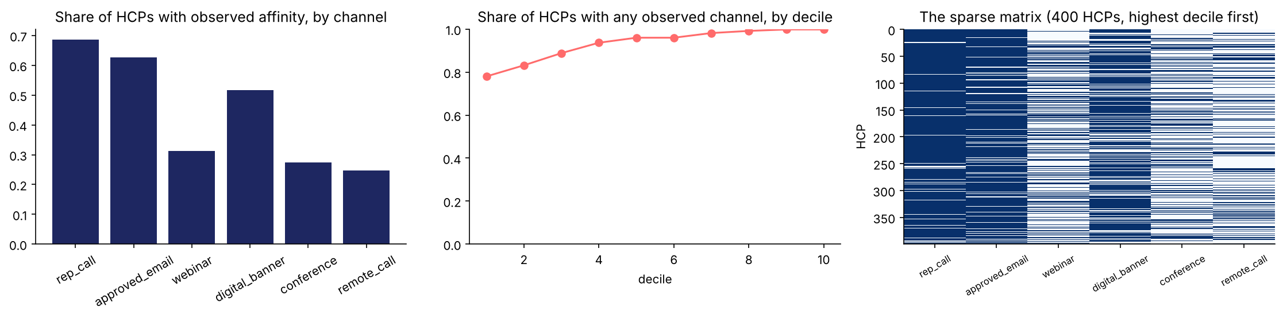
2 · AFFINITY, OBSERVED
Affinity is known for a subset — 44% of the HCP × channel cells
Six channels. History where the brand has touched the HCP on that channel; a 600-HCP preference survey covers all six.
rep call
email
webinar
digital
conf.
remote
Dr. Adler
.61
.33
.28
Dr. Bakshi
.48
?
.55
Dr. Costa
.36
?
Dr. Dunn
?
?
Dr. Eng
.41
.24
.33
.27
.31
.35
Dr. Farah
.58
.30
Dr. Goyal
?
.47
Why it is sparse, and sparse in a biased way
Dr. Hale
.66
.31
.49
.29
.57
.40
…
▸ Coverage follows the legacy call plan: high-decile HCPs are 'known' on call and email; webinar, conference and remote are rarely offered to anyone.
▸ 404 HCPs have no observed channel at all. The engine must still decide for them.
navy = observed engagement rate · ? = what the engine needs
Dr. Eng, Dr. Hale: surveyed (all six). Dr. Dunn: cold start.
A sparse HCP × channel matrix with blanks to fill is a recommender-system problem.
Week 5 — Omnichannel, NBA and Patient Predictive Modeling · Pharma DS&AI · Fall 2026
16 / 48
Notes:
§4 opening. The names are the exercise HCPs. Make the point that the blanks are not random — they are the channels nobody has tried on that HCP, which is exactly where the engine wants to go.

Slide 17
2 · COLLABORATIVE FILTERING
Filling the matrix with collaborative filtering
Matrix factorization with biases (Koren et al., 2009) on the residual from the segment prior; segment prior alone for cold start
Affinity matrix
6,000 HCPs × 6 channels · 44% known
≈
Segment × channel prior
micro-segmentation (Week 4)
+
HCP bias
engages more / less than the segment
+
HCP factors
2 numbers per HCP: people ↔ digital · promotional ↔ scientific
×
Channel loadings
2 numbers per channel, learned from everyone
RMSE (lower is better) | Held-out cells | HCPs with ≥ 3 known cells | Cold-start HCPs
Segment × channel mean | 0.184 | 0.182 | 0.185
kNN on Week 4 features | 0.188 | 0.190 | 0.189
Matrix factorization | 0.161 | 0.131 | 0.290
Hybrid (MF + prior) — ships | 0.146 | 0.131 | 0.185
Read it
▸ The segment prior is a strong baseline — that is what a good micro-segmentation buys.
▸ CF improves with history: 2–3 known channels place the HCP in the latent space.
▸ Cold start: nothing to factorize → the prior. Hybrid ships.
Correlation with the planted full matrix on the 56% of cells nobody observed: prior 0.55 → hybrid 0.68.
Week 5 — Omnichannel, NBA and Patient Predictive Modeling · Pharma DS&AI · Fall 2026
17 / 48
Notes:
§4a. Alternating ridge least squares, 30 iterations, k=2, strong shrinkage on the HCP side (1–2 cells per HCP) and almost none on the channel side (thousands of rows). causalml is not involved; this is the Netflix-prize method. Two uses: the segment × channel view, and the affinity floor in §7.

Slide 18
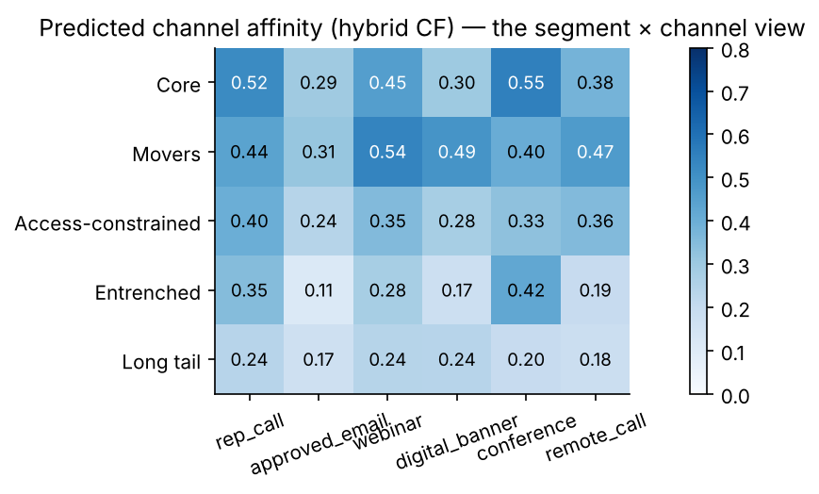
2 · AFFINITY, PREDICTED
The full matrix — and a check against revealed engagement
Hybrid CF output, averaged by segment. Validation: predicted affinity vs. observed engagement rate in the touch log, r = 0.20 / 0.29 / 0.33 (call / email / digital)
Affinity ≠ uplift
▸ Core: highest affinity on five of six channels, lowest return per dollar (§5).
▸ Movers: 0.49 digital, 0.54 webinar — affinity and uplift agree.
How the engine uses it
▸ Eligibility: a channel with predicted affinity < 0.15 is not offered (email blocked for 34% of HCPs, digital 25%, call 15%).
▸ Stated preference stays the other half: IQVIA Channel Dynamics.
Affinity decides how to reach an HCP. Uplift (§5) decides whether it pays. The segmentation sits under both.
Week 5 — Omnichannel, NBA and Patient Predictive Modeling · Pharma DS&AI · Fall 2026
18 / 48
Notes:
§4b. The correlation with revealed engagement is modest and should be: engagement in the log is a noisy binary over a handful of touches. Most 'NBA' platforms ship this layer and call it NBA.

Slide 19
03
Uplift modeling — a short course in causal inference
Why 'who prescribes after a call' and 'what the call did' are different questions, and how S-, T- and X-learners answer the second. Notebook §5.
Week 5 — Omnichannel, NBA and Patient Predictive Modeling · Pharma DS&AI · Fall 2026
19 / 48

Slide 20
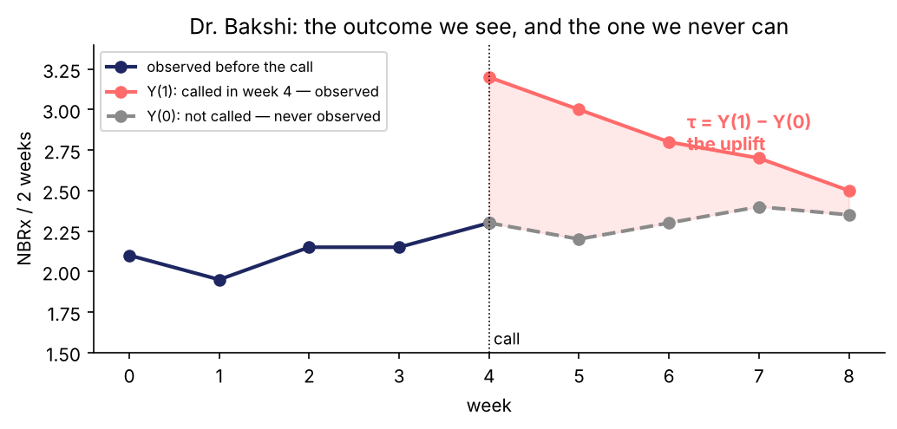
3 · POTENTIAL OUTCOMES
Two outcomes per HCP, one of them observed
The Neyman–Rubin framework: every HCP-week has an outcome if called, Y(1), and an outcome if not, Y(0)
τᵢ = Yᵢ(1) − Yᵢ(0)
the uplift of a call for HCP i
The fundamental problem
▸ We observe Y(1) or Y(0), never both. No row in any dataset has an uplift label.
So we estimate averages
▸ ATE = E[Y(1) − Y(0)]: the average over everyone.
▸ CATE τ(x) = E[Y(1) − Y(0) | X = x]: the average for HCPs like this one. The engine needs τ(x).
Uplift is a difference between two worlds. Only one is ever in the data.
Week 5 — Omnichannel, NBA and Patient Predictive Modeling · Pharma DS&AI · Fall 2026
20 / 48
Notes:
Define the two potential outcomes slowly. Students have seen prediction (one outcome, one label). This is the first time the target is a quantity that does not exist in any row. Everything in the section follows from that.

Slide 21
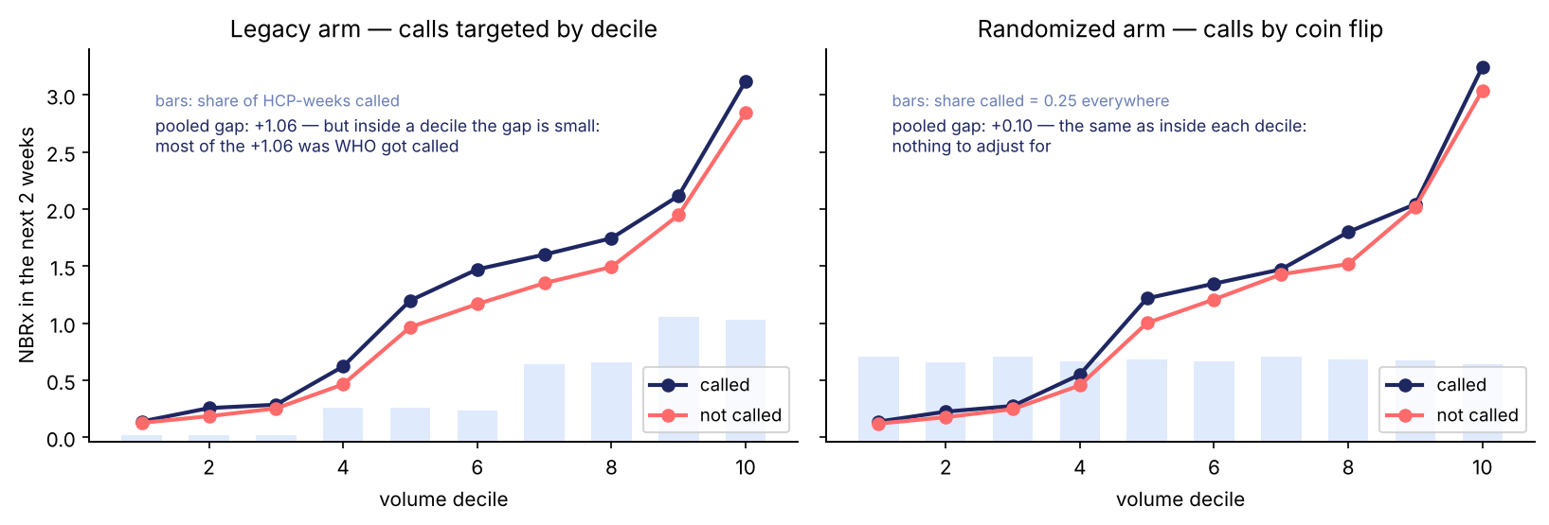
3 · CONFOUNDING
Why the naive comparison lies
Called vs. not called = the effect of the call + whatever made the rep call in the first place
Decile
(and segment, access…)
Rep call
NBRx
Two ways out
The confounder opens a back door: decile raises both the chance of a call and the NBRx. The naive gap mixes the navy arrow with the gold path.
Pooled gap +1.06; inside a decile it is small.
▸ Adjust for the confounders — works only if you know and measure all of them (here it is decile by construction; in reality it never is).
▸ Randomize the action — cuts the gold arrow into 'Rep call'. The exploration arm.
Observational: effect + selection. Randomized: effect. That is the whole case for the 25%.
Week 5 — Omnichannel, NBA and Patient Predictive Modeling · Pharma DS&AI · Fall 2026
21 / 48
Notes:
The DAG is the one slide of causal-graph language. Point at the gold arrow into Rep call: randomization deletes it. Adjustment leaves it but blocks the path — only if you have the variable.

Slide 22
3 · IDENTIFICATION
What randomization buys: three conditions, satisfied by design
The conditions under which a difference in means is the effect (Rubin's assumptions, in pharma words)
Exchangeability
Called and not-called HCP-weeks are alike except for the call. Coin flip ⇒ true. Legacy arm ⇒ false (decile).
Overlap (positivity)
Every kind of HCP had a real chance of every action. 0.25 each ⇒ true. Legacy: Long-tail HCPs are almost never called ⇒ no overlap there.
Consistency / no interference
A 'call' means the same thing for everyone, and one HCP's call does not change another's outcome. Mostly true; peer effects are the exception.
ATE = E[Y | call] − E[Y | none] on the randomized rows = +0.10 NBRx per 2 weeks ($120 of margin for $180)
When you cannot randomize
Why the exploration arm stays on
▸ Propensity weighting, matching, difference-in-differences, synthetic controls (ZS 2026) — all rest on exchangeability you have to argue for.
▸ Next quarter's CATE, OPE and the fatigue curve all need rows where these three hold.
Randomization is not a statistics nicety. It is what makes the number mean what the brand thinks it means.
Week 5 — Omnichannel, NBA and Patient Predictive Modeling · Pharma DS&AI · Fall 2026
22 / 48

Slide 23
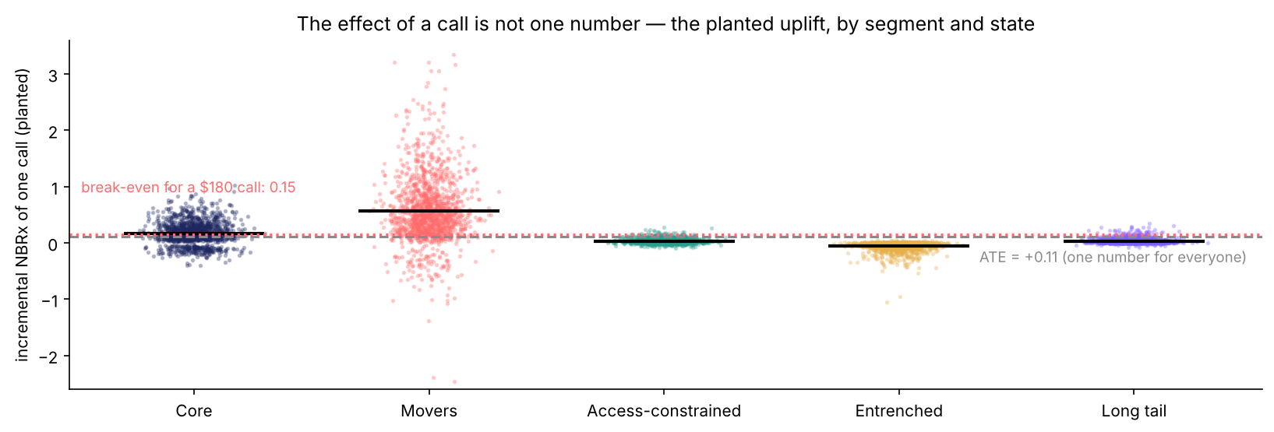
3 · HETEROGENEITY
One number is not enough
The planted uplift of a call, for every hold-out HCP-week, by Week 4 segment
The ATE hides the decision
CATE τ(x) is the target
▸ +0.11 on average; Movers +0.6, Entrenched below zero. A call pays for Movers and loses money almost everywhere else.
▸ x = segment, baseline, touches this month, last action, consent, access. The uplift model estimates τ(x) from the randomized rows.
The engine does not need the average effect. It needs the effect for this HCP, this week.
Week 5 — Omnichannel, NBA and Patient Predictive Modeling · Pharma DS&AI · Fall 2026
23 / 48

Slide 24
3 · PREDICTION vs. UPLIFT
Same data, different target
A response model and an uplift model can share features, algorithm and code — and answer different questions
 | Response (prediction) model | Uplift (causal) model
Target | E[Y | x, call] — NBRx after a call | τ(x) = E[Y | x, call] − E[Y | x, none]
Label in the data | Yes: NBRx | No: never observed for any row
Rows it can use | Any — but learns the targeting rule on observational rows | Randomized (or credibly adjusted) rows only
Ranks first | Sure things — Core, decile 10 | Persuadables — Movers
Evaluated by | AUC, RMSE, R² | Uplift by decile, Qini — on groups, not rows
Pharma name | Promotion response; 'propensity to prescribe' | Uplift / incremental lift; heterogeneous treatment effect
A high-AUC response model can rank HCPs by uplift no better than chance. Different target, different model.
Week 5 — Omnichannel, NBA and Patient Predictive Modeling · Pharma DS&AI · Fall 2026
24 / 48
Notes:
Interview question: 'we have a great propensity model, why build another?' Answer with the 'ranks first' row and the decile chart four slides on.

Slide 25
3 · S-LEARNER
S-learner: one model, the action is a feature
Single model · simplest · uses every row
f(x, call)
all randomized rows
x and the action a
f(x, a)
one GBM
−
τ̂_S(x)
flip the feature, subtract
f(x, none)
Why it under-shoots
When to use it
▸ The action is one feature among ~40. Regularization treats it like any other: where the tree does not split on it, τ̂ = 0.
▸ Tonight: predicted sd 0.21 vs planted 0.31 — compressed toward zero; fewer HCPs cross break-even than should.
▸ Correlation with truth 0.74 (highest) — it gets the order right and the size wrong.
▸ Small data; many actions (one model, not one per arm).
▸ When the effect is large relative to noise.
▸ Qini tonight (call / email / digital): 133 / 75 / 74.
Simple and honest about order; biased toward 'no effect'.
Week 5 — Omnichannel, NBA and Patient Predictive Modeling · Pharma DS&AI · Fall 2026
25 / 48

Slide 26
3 · T-LEARNER
T-learner: one model per arm, then subtract
Two models · no shrinkage · noisy where an arm is thin
called rows
f₁(x)
GBM on called
−
τ̂_T(x) = f₁(x) − f₀(x)
not-called rows
f₀(x)
GBM on not called
Why it over-shoots
When to use it
▸ Each model sees only its own rows (≈ 7,000 each); the two fit the noise differently and the difference inherits both errors.
▸ Tonight: predicted sd 0.52 vs planted 0.31 — too spread; correlation 0.50.
▸ Digital Qini 18: a small effect drowned by two noisy models.
▸ Arms of similar size with plenty of rows; outcomes that differ in shape by arm.
▸ Qini tonight: 174 / 51 / 18.
▸ The baseline every other learner is measured against.
No bias toward zero — but the difference of two noisy models is noisier still.
Week 5 — Omnichannel, NBA and Patient Predictive Modeling · Pharma DS&AI · Fall 2026
26 / 48

Slide 27
3 · X-LEARNER
X-learner: impute each row's effect, then model the effect itself
Two stages · built for unequal arms · the production model tonight
Stage 1
T-learner: f₁ on called, f₀ on not called
Impute
called rows: D¹ = Y − f₀(x)
not-called rows: D⁰ = f₁(x) − Y
Stage 2
g₁(x) on D¹ · g₀(x) on D⁰ — models of the effect
Blend
τ̂_X = g(x)·g₀(x) + (1−g(x))·g₁(x); g = propensity (0.5 here)
Why the second stage helps
When to use it
▸ Stage 2 fits a model of τ directly on pseudo-labels, so the effect is the target, not a leftover of two outcome fits.
▸ Each row is used twice — once for its own arm, once imputed — so thin arms borrow strength.
▸ Tonight: sd 0.42 vs 0.31; correlation 0.59; Qini 192 / 76 / 62 — best or tied on every channel.
▸ Unequal arms — the normal case: a 90% control arm in a real log.
▸ Small effects in noisy outcomes (the email).
▸ The blend weight is the propensity; with a 25% exploration arm it is known, not estimated.
The effect becomes the target. That is why it wins on the email and ships in §7.
Week 5 — Omnichannel, NBA and Patient Predictive Modeling · Pharma DS&AI · Fall 2026
27 / 48
Notes:
Künzel et al. (2019) for the X-learner; the S/T names are theirs too. causalml and econml wrap all three; writing them once is how you know what the two lines do.

Slide 28
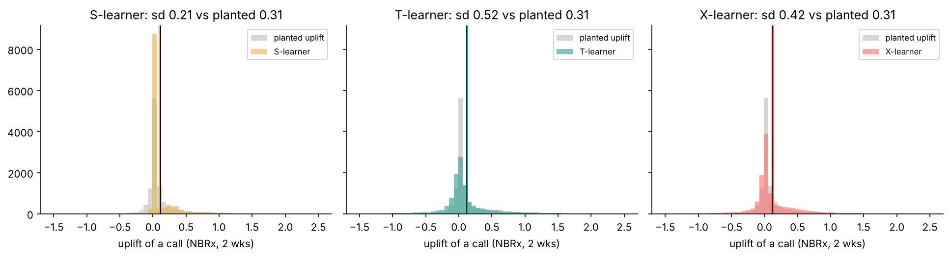
3 · WHAT EACH PRODUCED
The same hold-out, three distributions of τ̂
Planted uplift (grey) vs. each learner's predictions; vertical lines = means
S shrinks
T spreads
X is closest
▸ sd 0.21 < 0.31. The mass sits at zero.
▸ sd 0.52 > 0.31. Long tails on both sides are noise.
▸ sd 0.42. Still too wide — 26 weeks of a 25% arm.
Three estimators of the same quantity disagree on its scale. The ranking is what the engine uses; the scale is what the finance case uses.
Week 5 — Omnichannel, NBA and Patient Predictive Modeling · Pharma DS&AI · Fall 2026
28 / 48

Slide 29
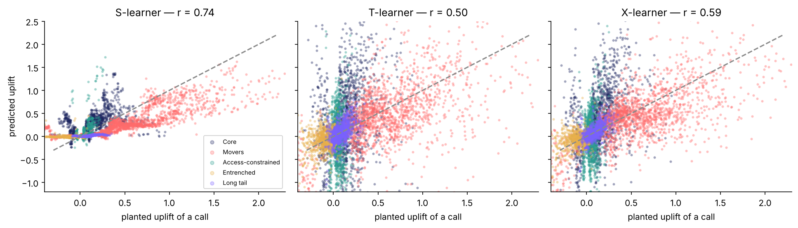
3 · AGAINST THE TRUTH
Predicted vs. planted uplift, hold-out HCP-weeks
Synthetic data's one luxury: the label that never exists in a real log
Read the colour
▸ Movers (coral) are the persuadables — every learner puts them top right. Entrenched (gold) sit at or below zero. Within a segment the spread is the state: touches this month, last action.
Segment order: easy. Within-segment state: harder. Individual HCP: beyond this data.
Week 5 — Omnichannel, NBA and Patient Predictive Modeling · Pharma DS&AI · Fall 2026
29 / 48

Slide 30
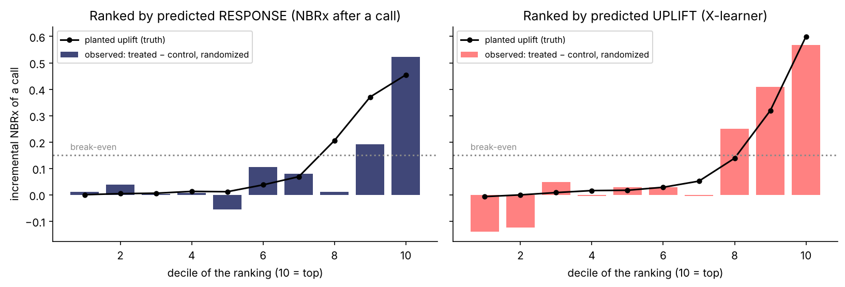
3 · THE PAYOFF
Rank by response, or rank by uplift — same HCPs, same randomized outcomes
Hold-out HCP-weeks cut into deciles of each ranking; bars = treated − control inside the decile (randomized, so this is the real effect)
Response ranking
Uplift ranking
▸ Top decile +0.45 — but decile 9 (Core) barely clears break-even and deciles 1–8 are flat: it found big baselines, not persuadables.
▸ Deciles 8–10 all above break-even and rising; the bottom deciles are sleeping dogs the engine should not touch.
The response model's top decile is worth calling. The uplift model's top three are — and it knows whom to leave alone.
Week 5 — Omnichannel, NBA and Patient Predictive Modeling · Pharma DS&AI · Fall 2026
30 / 48
Notes:
This is the slide that settles the 'why not our propensity model' argument. Both rankings are evaluated on randomized outcomes, so the bars are honest for both.

Slide 31
3 · THE FAMILY
Meta-learners side by side — and the causal forest
All on the 39,000 randomized HCP-weeks, hold-out split by HCP
S-learner
T-learner
X-learner
one model
f(x, action)
model on
call rows
model on
none rows
T-learner
τ̂ = f(x, call) − f(x, none)
τ̂ = f₁(x) − f₀(x)
impute each row's effect
model the effect itself
simple · shrinks the effect toward 0
honest · noisy where rows are few
built for unequal arms · regularizes
Qini (hold-out) | S | T | X | response model
call | 133 | 174 | 192 | 110
email | 75 | 51 | 76 | 72
digital | 74 | 18 | 62 | 33
Causal forest (optional)
▸ econml CausalForestDML — honest trees on the effect (Athey & Imbens). Same data limits, valid intervals.
X-learner wins or ties every channel → it is the production model from §7 on. Grade on Qini, never on R².
Week 5 — Omnichannel, NBA and Patient Predictive Modeling · Pharma DS&AI · Fall 2026
31 / 48
Notes:
§5. causalml / econml do all three in two lines; writing them once is how you know what the two lines do.

Slide 32
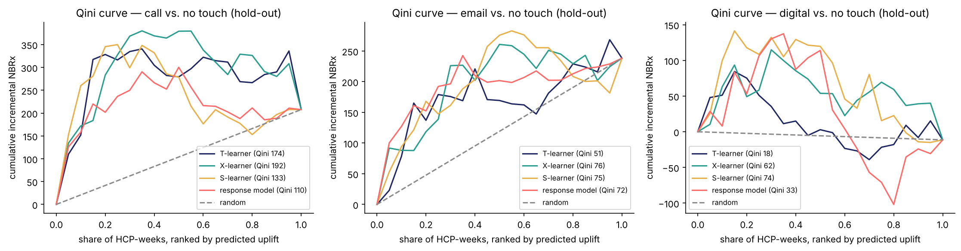
3 · QINI
Evaluating uplift without individual labels
Rank by predicted uplift → inside each decile, compare randomized treated vs. control → cumulate
Call
Email
▸ Every learner beats the response model. X-learner top deciles: +0.60, +0.52 observed NBRx.
▸ T 51 → X 76: the second stage finds a small effect in noisy counts.
A curve that rises fast then flattens found the persuadables and ran out.
Week 5 — Omnichannel, NBA and Patient Predictive Modeling · Pharma DS&AI · Fall 2026
32 / 48

Slide 33
04
Saturation, rules, and the scoring layer
The marginal touch has its own curve. The rules fall out of it; the score sits behind them. Notebook §6–7.
Week 5 — Omnichannel, NBA and Patient Predictive Modeling · Pharma DS&AI · Fall 2026
33 / 48

Slide 34
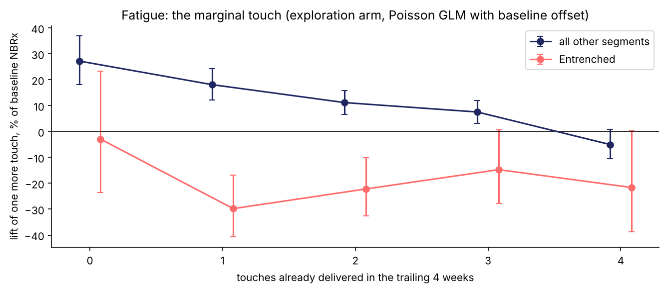
4 · SATURATION
The marginal touch
IQVIA (2018): digital's early success 'resulted in overkill and saturation'. Measured here on the randomized rows.
Touches already (4 wks) | Others | Entrenched
0 | +27% | −3%
1 | +18% | −30%
2 | +11% | −22%
3 | +8% | −15%
4 | −5% | −22%
Two more rules
▸ Email after a quiet week +10%; after a call +2%.
▸ No consent: 2,450 emails, 135 complaints, no lift.
Cap: 3 touches per 4 weeks (2 for Entrenched). No email within a week of a call. Consent is a hard gate.
Week 5 — Omnichannel, NBA and Patient Predictive Modeling · Pharma DS&AI · Fall 2026
34 / 48
Notes:
§6. Entrenched = sleeping dogs. The cap is estimated, not guessed — and re-estimated every refresh.

Slide 35
4 · BUSINESS RULES
Rules run before the model
Axtria: 'AI/ML models, business rules, and governance'
Rule | Definition | Type | Owner
Consent | No email without opt-in; no retargeting without cookie consent | Hard | Compliance
Frequency cap | ≤ 3 touches / 4 weeks (≤ 2 Entrenched) | Hard | Brand + Field
Call recency | No call within 2 weeks of a call; field may override with a reason | Soft | Field
Sequencing | No email the week after a call | Soft | Omnichannel
Complaint hold | 8 weeks of email silence | Hard | Compliance
MI hold | No promotion while a medical-information request is open | Hard | Medical
Access trigger | Reject rate > 25% → access content replaces efficacy content | Content | Market Access
Affinity floor | Predicted affinity < 0.15 → channel not offered (§4) | Hard | Analytics + Omnichannel
Holdout · exploration | 10% of HCPs outside the engine · 25% of weeks randomized | Design | Analytics
Going into next week: cap blocks 42% of HCPs, consent 25%, recency 32%, affinity floor 50% (some channel). The engine's first job is to say no.
Week 5 — Omnichannel, NBA and Patient Predictive Modeling · Pharma DS&AI · Fall 2026
35 / 48

Slide 36
4 · SCORING
One HCP, four scores, one answer
value(a) = τ̂ₐ(x) × $1,200 − cost(a) · Dr. Eng, Access-constrained, 1 touch this month, consent ✓, last action: none
action
τ̂ (NBRx, 2 wks)
× $1,200
− cost
= value
eligible?
Call
+0.05
$60
$180
−$120
✗ recency rule
Email
+0.35
$420
$2
+$418
✓
Digital
+0.08
$96
$6
+$90
✓
Nothing
0
$0
$0
$0
✓
argmax over eligible actions → approved email (access/copay content). Suggestion to the rep: none this week.
Across 6,000 HCPs: calls 955 → 297 a week; 60% get nothing. Model-estimated value $838k vs $169k for the legacy mix.
Week 5 — Omnichannel, NBA and Patient Predictive Modeling · Pharma DS&AI · Fall 2026
36 / 48
Notes:
§7. Dr. Eng is exercise Part A. 'Model-estimated' is the operative word — §8 checks it.

Slide 37
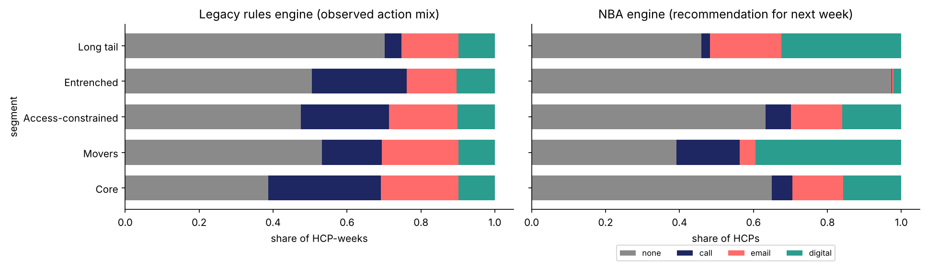
4 · THE ENGINE'S ANSWER
Legacy engine vs. NBA engine — next week's mix
Same model scoring both
What moved
▸ Calls: from Core and Entrenched to Movers.
▸ Movers → digital (39%).
▸ Access-constrained → the access email.
▸ Entrenched: 97% nothing.
▸ Top 10 by value: nine Movers, mostly digital — $6 beats $180.
A $6 placement with 0.4 NBRx of uplift beats a $180 call with 0.45.
Week 5 — Omnichannel, NBA and Patient Predictive Modeling · Pharma DS&AI · Fall 2026
37 / 48

Slide 38
05
Evaluating a policy: OPE and bandits
Score the new policy on the old log before anyone changes the call plan. Then keep learning. Notebook §8–9.
Week 5 — Omnichannel, NBA and Patient Predictive Modeling · Pharma DS&AI · Fall 2026
38 / 48

Slide 39
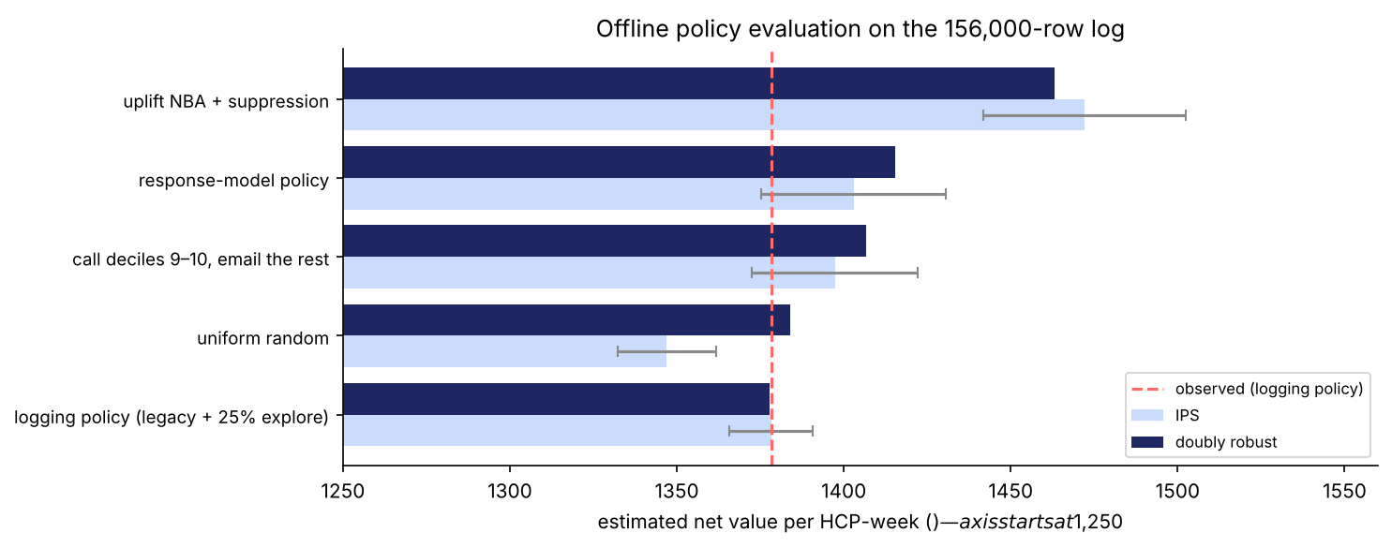
5 · OPE
Offline policy evaluation — re-weight the log
Each logged row is re-weighted by π(a|x) / p(a|x): how much more (or less) the new policy would have taken that action
Logged row
context x · action a
p(a|x) · reward r
New policy says
π(a|x)
Weight
w = π(a|x) / p(a|x)
Estimate
V̂ = mean(w · r)
Policy | IPS | SNIPS | DR | eff. n
Logging policy (sanity check) | $1,378 | $1,378 | $1,378 | 156,000
Response-model policy | $1,403 | $1,411 | $1,415 | 30,400
Uplift NBA + rules | $1,472 | $1,483 | $1,463 | 37,000
Three estimators
▸ IPS unbiased, high variance · SNIPS normalizes the weights · DR adds a reward model and is right if either part is
NBA: +$94 per HCP-week (±$32), all three estimators agree. Enough for an A/B test — not for a rollout.
Week 5 — Omnichannel, NBA and Patient Predictive Modeling · Pharma DS&AI · Fall 2026
39 / 48
Notes:
§8. Net value per HCP-week = $1,200 × NBRx − cost. Effective n is the price of OPE: a policy far from the logger is scored on a fraction of the rows. +$100 × 6,000 × 52 ≈ $31M a year modeled — quote the interval.

Slide 40
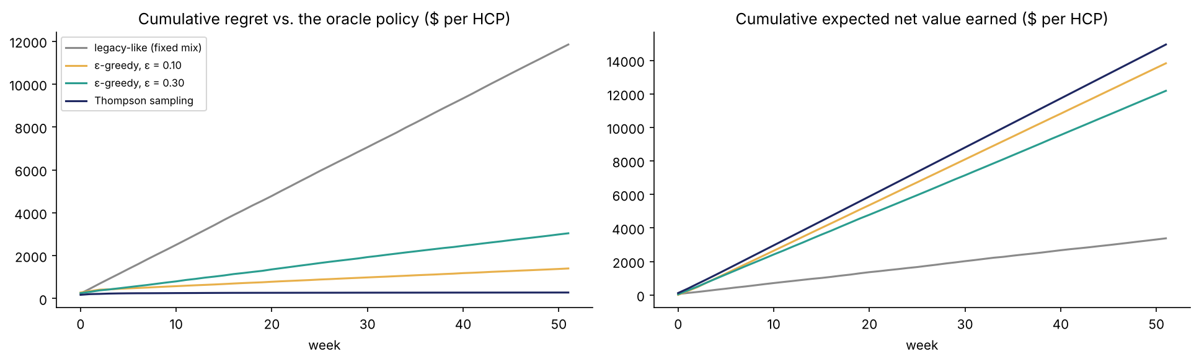
5 · BANDITS
Keep learning: the contextual bandit loop
Online-advertising vocabulary (Li et al. 2010) — not a pharma term, but the mechanism behind 'exploration'
Context
segment, state
Choose
ε-greedy or Thompson
Reward
net value, noisy
Update
posterior per arm
Policy (52 wks) | Regret / HCP
Fixed mix | $11,848
ε = 0.10 | $1,403
ε = 0.30 | $3,044
Thompson | $282
▸ Thompson explores where uncertain, then stops.
The exploration arm of §1 is the same thing seen from the other side.
Week 5 — Omnichannel, NBA and Patient Predictive Modeling · Pharma DS&AI · Fall 2026
40 / 48

Slide 41
06
Patients, orchestration, exercise
The same engine for patients, under stricter governance; what turns a model into a program. Notebook §10–11.
Week 5 — Omnichannel, NBA and Patient Predictive Modeling · Pharma DS&AI · Fall 2026
41 / 48

Slide 42
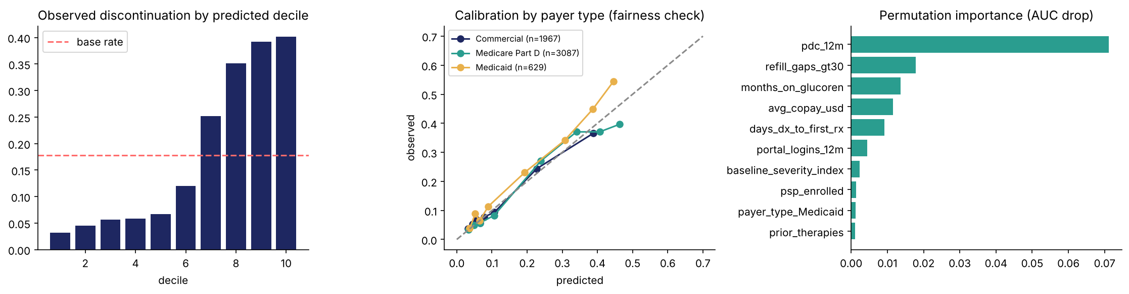
6 · PATIENT NBA
The patient-side engine
Week 4 patient file · discontinuation within 12 months · AUC 0.77
Patient journey
claims → PDC, gaps, copay, PSP, portal
Risk score
GBM, allowed features only
Rules
consent · purpose · fairness by payer
Outreach
PSP enrollment · copay card · nudge
Nurse decides
model ranks, human acts
Top two risk deciles: 40% discontinue (base 18%) and hold 45% of all discontinuers. That is a nurse's call list.
Week 5 — Omnichannel, NBA and Patient Predictive Modeling · Pharma DS&AI · Fall 2026
42 / 48
Notes:
§10. PDC and refill gaps dominate importance (near-tautological); copay and PSP are the actionable ones. Calibration by payer is the fairness check — sits on the diagonal for all three.

Slide 43
6 · GOVERNANCE
A score about a person
Six controls, in the order a privacy review asks
Purpose limitation
supports adherence; never deprioritizes
Data minimization
the feature list, nothing else
Channel consent
PSP consent; HCP office as default
Fairness before launch
calibration by payer and specialty
Drift monitoring
monthly, with an owner
Human in the loop
nurse decides; override rate is a metric
IQVIA, Trustworthy AI/ML for Patient Analytics: outputs such as “risk stratification scores” undergo validation; metrics include “fairness and bias detection” and drift monitoring.
Week 5 — Omnichannel, NBA and Patient Predictive Modeling · Pharma DS&AI · Fall 2026
43 / 48

Slide 44
6 · ORCHESTRATION
What turns a model into a program
IQVIA: a 'common data spine'. ZS/Axtria: next best experience, closed-loop learning.
Measurement
10% global holdout · 25% exploration · OPE quarterly · A/B of engine versions · report incremental NBRx and net value, not engagement
Activation
CRM suggestion to the rep · email platform · digital · patient support program
Decision
segmentation → affinity prediction → business rules → uplift model → selection + exploration
Data (CDP)
identity · consent · touch history · Rx · segments — the single customer view
Triggers
Owners
▸ NBRx jump · reject rate > 25% · Week 4 exit trigger · refill gap > 30 days
▸ Rules: compliance + field · content: access + medical · model: analytics · rollout: brand
Week 5 — Omnichannel, NBA and Patient Predictive Modeling · Pharma DS&AI · Fall 2026
44 / 48

Slide 45
6 · PITFALLS
Five ways NBA programs fail
Optimizing engagement
opens and clicks drift the engine toward Core
Turning off exploration
by Q3 nobody can tell Movers became Core
A response model with a causal name
'propensity to prescribe' on observational rows = §3
Rules nobody can read
estimate the cap, then write it down
Rolling out on the OPE
it justifies the A/B, not the launch
When not to build one
< 1,500 HCPs · nothing can be randomized · the constraint is access, not attention
Week 5 — Omnichannel, NBA and Patient Predictive Modeling · Pharma DS&AI · Fall 2026
45 / 48

Slide 46
6 · EXERCISE
In-class exercise — 20 minutes, groups of 3–4
Week_05_InClass_Exercise.docx
A
A · Uplift by hand (7 min)
B
B · Write the rules (8 min)
C
C · Pick the evaluation (5 min)
▸ Eight HCPs from the randomized arm. Response, uplift, net value per action.
▸ Who would a response model call? Who does the engine touch?
▸ Per Week 4 segment: default action, cap, one rule, one trigger.
▸ Which segment does the engine leave alone?
▸ Six scenarios: OPE, global holdout, A/B, geo test, or 'cannot be evaluated'.
Short on time: Part A only. Answer key in the instructor folder.
Week 5 — Omnichannel, NBA and Patient Predictive Modeling · Pharma DS&AI · Fall 2026
46 / 48

Slide 47
6 · NEXT WEEK
Week 6 — Forecasting
Monday, October 19 · Homework 2 released
Before Week 6
Bring
▸ Read: Reading Pack Parts B–D; Athey & Imbens §1–3 (skim proofs).
▸ Watch: PMSA 'From Multichannel to Omnichannel', part 1.
▸ Install: statsforecast.
▸ Submit: Homework 1 — tonight, 11:59 PM ET.
▸ Your Part B rule table.
▸ One answer: what share of weeks would your brand team accept as randomized, and what would you offer for it?
▸ Term project: segmentation + NBA archetype → the exploration arm goes in your data plan, or your evaluation is observational and says so.
Office hours Mondays 5:00–6:45 PM · ac5562@columbia.edu
Week 5 — Omnichannel, NBA and Patient Predictive Modeling · Pharma DS&AI · Fall 2026
47 / 48

Slide 48
Questions?
1 · Model the difference, not the level.
2 · Randomize a share of decisions — and keep it on.
3 · Segmentation says who; affinity (collaborative filtering) says how to reach them; uplift says whether it pays.
4 · The marginal touch has its own curve; the rules run in front of the model.
5 · Score offline, quote the interval, then A/B.
6 · Patients: same engine, stricter governance, a human at the point of contact.
Next week — Forecasting · Homework 2 released October 19
Week 5 — Omnichannel, NBA and Patient Predictive Modeling · Pharma DS&AI · Fall 2026
48 / 48

